Slide 1
Transformer
Paper Summary

Slide 2
References
Vaswani et al – Google Brain/Research, Attention is All you Need, NeurIPS 2017.
Dosovitskiy et al – Google Research/Brain, An Image is Worth 16x16 Words: Transformers for Image Recognition at Scale, ICLR 2021.
Liu et al – Microsoft Research Asia, Swin Transformer: Hierarchical Vision Transformer using Shifted Windows, ICCV 2021.

Slide 3
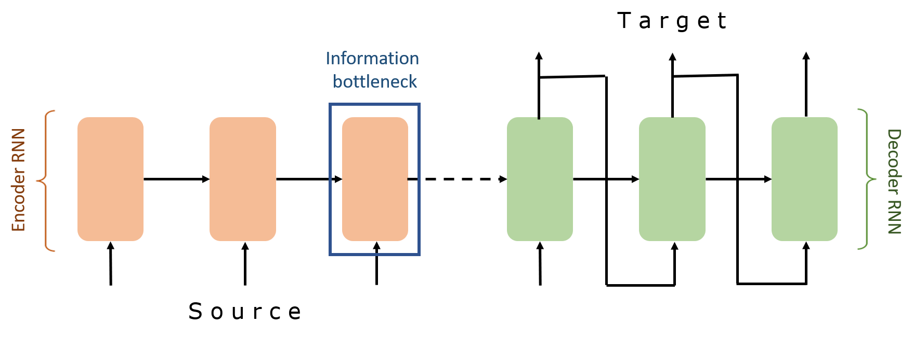
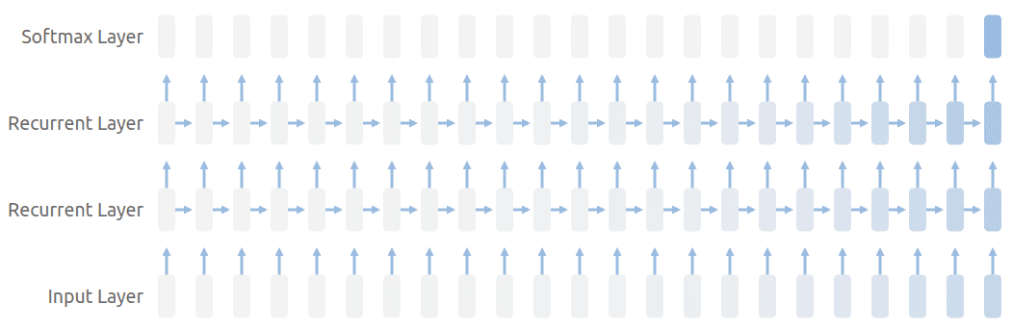
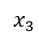
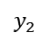
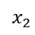
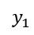
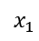
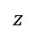
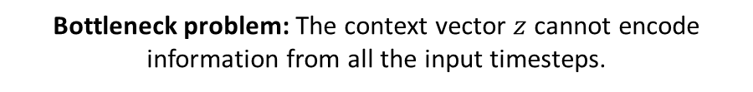
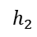
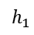
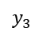
Background
RNN/LSTM networks:
SOTA approaches in sequential modeling (language modeling, machine translation…)
Suffers from bottleneck and vanishing gradient problems with long sequence.
→ Attention mechanism was born.
$$y_{1}$$
$$y_{2}$$
$$y_{3}$$
$$h_{1}$$
$$h_{2}$$
$$z$$
$$x_{1}$$
$$x_{2}$$
$$x_{3}$$
Bottleneck problem: The context vector $z$ cannot encode information from all the input timesteps.
Vanishing gradient problem: Contribution from earlier steps becomes insignificant in the gradient for the vanilla RNN unit.
Notes:
Context vector z is a function of just the last encoder hidden state

Slide 4
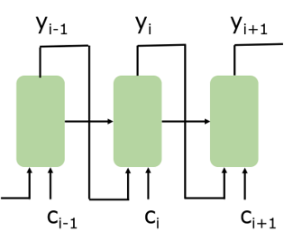
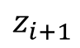

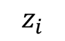
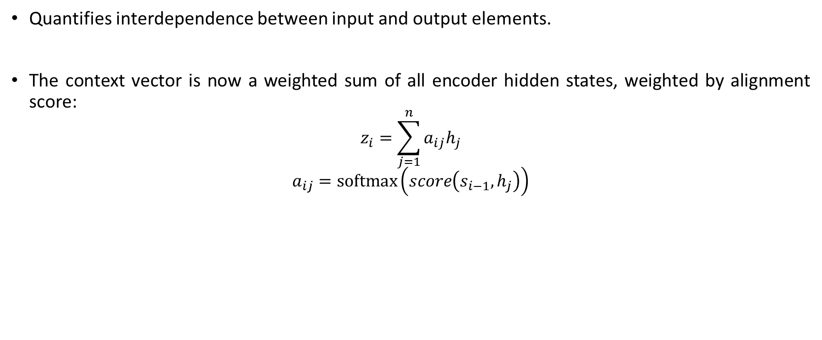
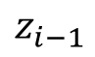
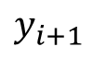
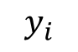

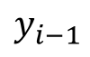
Attention Mechanism
Quantifies interdependence between input and output elements.
The context vector is now a weighted sum of all encoder hidden states, weighted by alignment score:
$$z_{i}=\sum_{j=1}^{n}{a_{ij}h_{j}}$$
$$a_{ij}=softmax\left(score\left(s_{i−1},h_{j}\right)\right)$$
Number of encoder hidden states
Encoder hidden state for the $j$th input
$$y_{i−1}$$
$$y_{i}$$
$$y_{i+1}$$
Decoder hidden state for the $\left(i−1\right)$th input
$$z_{i−1}$$
$$z_{i}$$
$$z_{i+1}$$
Decoder RNN

Slide 5
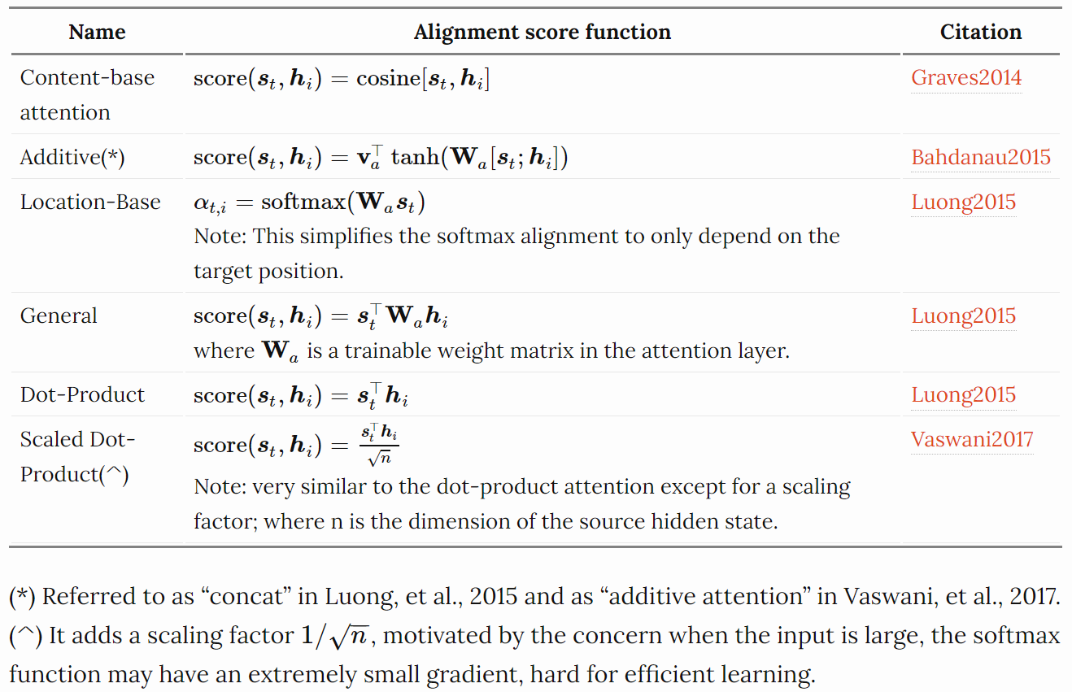
Attention Mechanism
Popular attention mechanisms:
Transformer’s self-attention
Notes:
Theoretically the self-attention can adopt any score functions, but just replace the target sequence with the same input sequence.

Slide 6
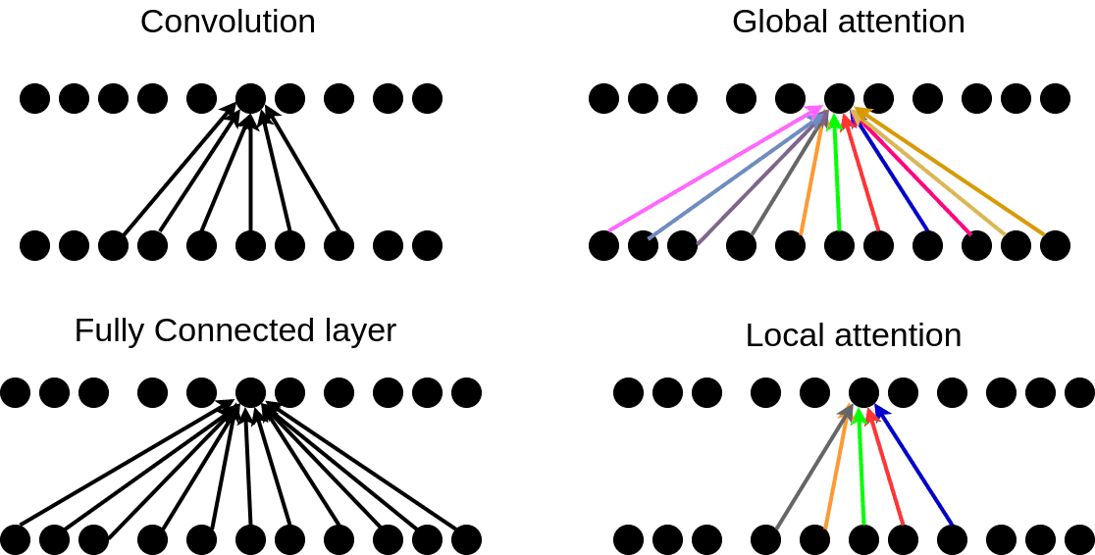
Attention Mechanism
Categories:
Global / Soft: attends to the entire input state space.
Local / Hard: attends to a part of input state space.
Notes:
- With global attention, model is smooth but can be computational expensive.
- With local attention has lower complexity but may require complex engineering to implement efficiently.
- The colors in the attention indicate that these weights are constantly changing while in convolution and fully connected layers they are slowly changing by gradient descent.

Slide 7
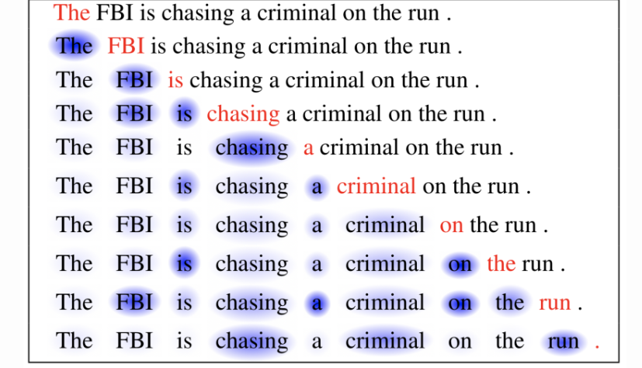
Self-Attention Mechanism
Relates different positions of the same input sequence.
Theoretically the self-attention can adopt any score functions, but just replace the output sequence with the same input sequence.
Notes:
Instead of between input and output elements.

Slide 8

Transformer Model Architecture
* Actual encoder and decoder each consists of 6 blocks
Notes:
Embedding dimension = 512
There are dependencies between these paths in the self-attention layer. The feed-forward layer does not have those dependencies → can be executed in parallel

Slide 9
Transformer Model Architecture
Multi-Head Self-Attention
Multi-Head Encoder-Decoder Attention
Multi-Head Self-Attention
Masked Multi-Head Self-Attention
* Actual encoder and decoder each consists of 6 blocks
Notes:
Embedding dimension = 512
There are dependencies between these paths in the self-attention layer. The feed-forward layer does not have those dependencies → can be executed in parallel

Slide 10
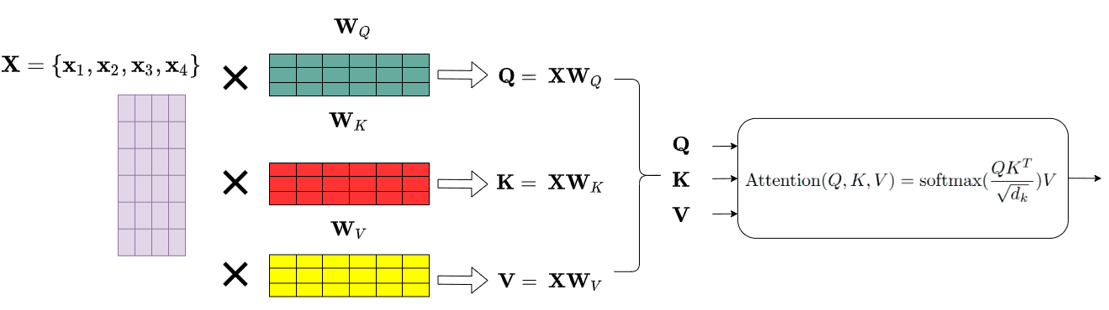
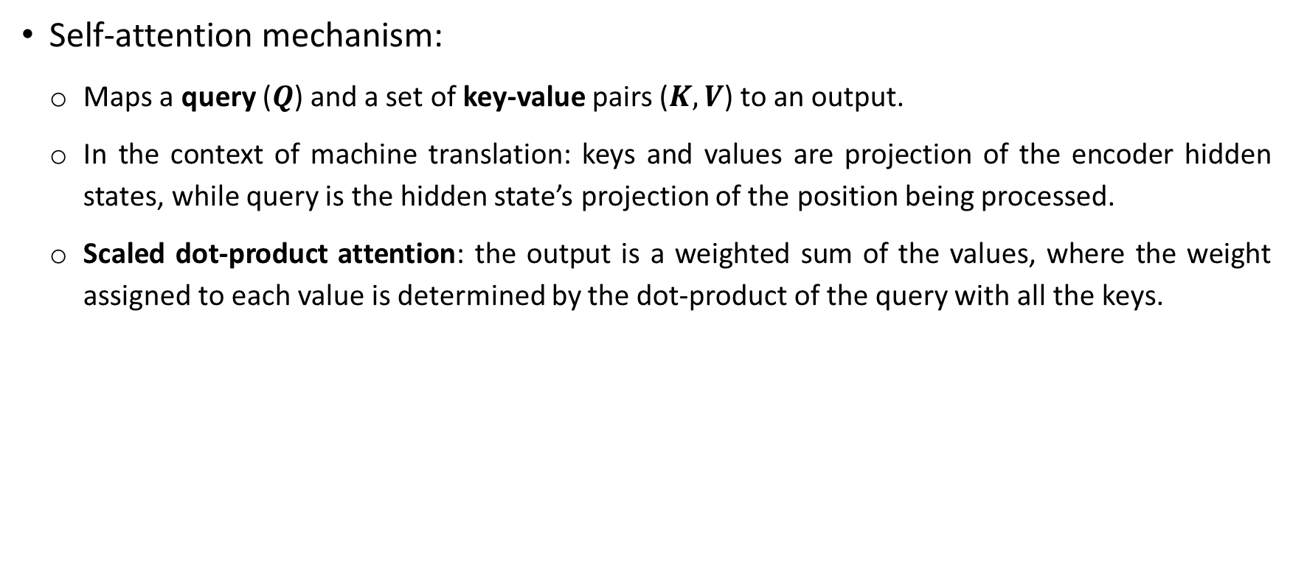
Transformer Multi-Head Self-Attention Mechanism
Self-attention mechanism:
Maps a query ($Q$) and a set of key-value pairs ($K,V$) to an output.
In the context of machine translation: keys and values are projection of the encoder hidden states, while query is the hidden state’s projection of the position being processed.
Scaled dot-product attention: the output is a weighted sum of the values, where the weight assigned to each value is determined by the dot-product of the query with all the keys.
Notes:
- $Q, K, V$are basically projection of embedded vectors with $W_{Q}$, $W_{K}$, $W_{V}$.
- New vectors are smaller in dimension than the embedding vector. Their dimensionality is 64, while the embedding and encoder input/output vectors have dimensionality of 512. - They don’t HAVE to be smaller, this is an architecture choice to make the computation of multiheaded attention (mostly) constant.

Slide 11
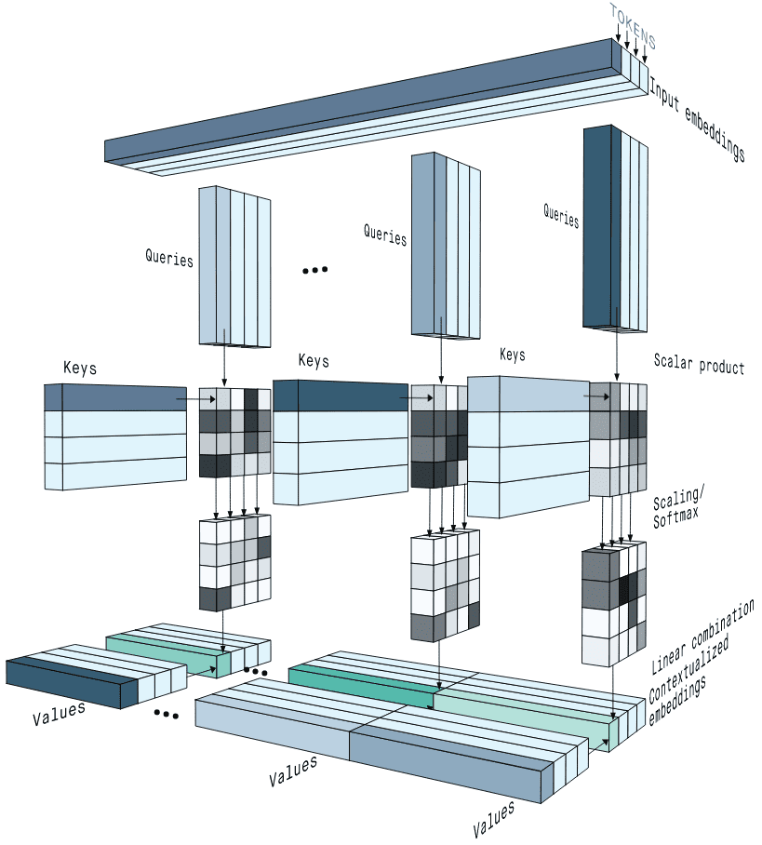
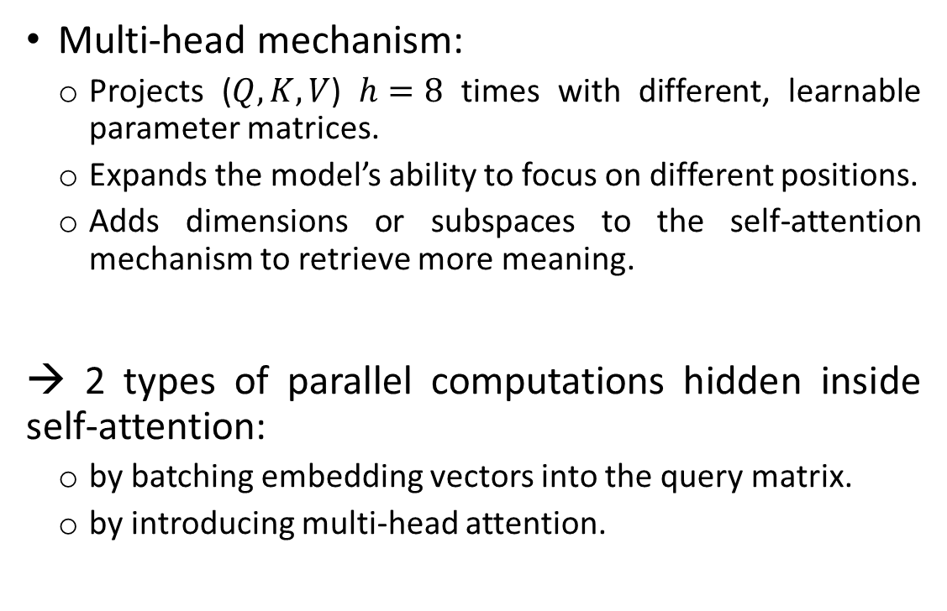
Transformer Multi-Head Self-Attention Mechanism
Multi-head mechanism:
Projects ($Q,K,V$) $h=8$ times with different, learnable parameter matrices.
Expands the model’s ability to focus on different positions.
Adds dimensions or subspaces to the self-attention mechanism to retrieve more meaning.
→ 2 types of parallel computations hidden inside self-attention:
by batching embedding vectors into the query matrix.
by introducing multi-head attention.

Slide 12
Transformer Multi-Head Self-Attention Mechanism
3 different ways of usage:
Self-Attention layers: Keys, values and queries come from previous encoder layer. Each position can attend to all positions.
Masked Self-Attention layers: Keys, values and queries come from previous decoder layer. Each position can only attend to current and earlier positions in the output sequence.
Encoder-Decoder Attention layers: Queries come from previous decoder layer, while memory keys and values come from output of the encoder. Every decoder position can attend over all positions in the input sequence (mimics the general attention mechanism).

Slide 13
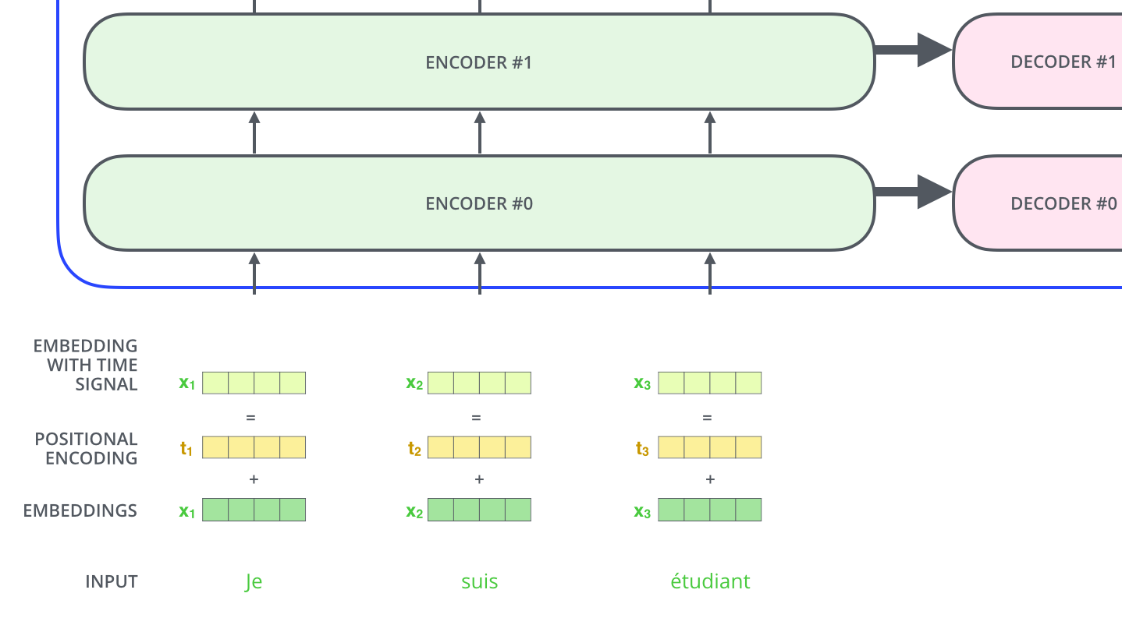
Transformer Positional Encoding
Inject information about position of the tokens in the sequence to the input embeddings
Provide meaningful distances between embedding vectors.

Slide 14

Transformer Operation (1)

Slide 15

Transformer Operation (2)

Slide 16
Transformer Observations
Significance:
Increase amount of parallelized computation.
Improve ability to learn long-range dependencies.
Lead to development of many attention-based and transformer-based methods in many fields.
Limitation:
Attention can only deal with fixed-length text strings. The text must be split into a certain number of segments without respecting the sentence or any other semantic boundary being fed into the system → causes context fragmentation.
Notes:
Self-attention versus Convolution:
Self-attention has data-dependent dynamic weights as they change dynamically in response to the data.
In convolution, the weights are fixed globally, which enables translational equivariance property.

Slide 17
Vision Transformer (ViT)
Transformer based applications to computer vision remain limited.
Self-attention based vision applications:
Limit to local attention -> able to replace conv.
Employ scalable approximations to global attention -> require complex engineering.
Apply full self-attention on extracted 2x2 patches -> limit to small-res images.
Combines conv with forms of self-attention.

Slide 18
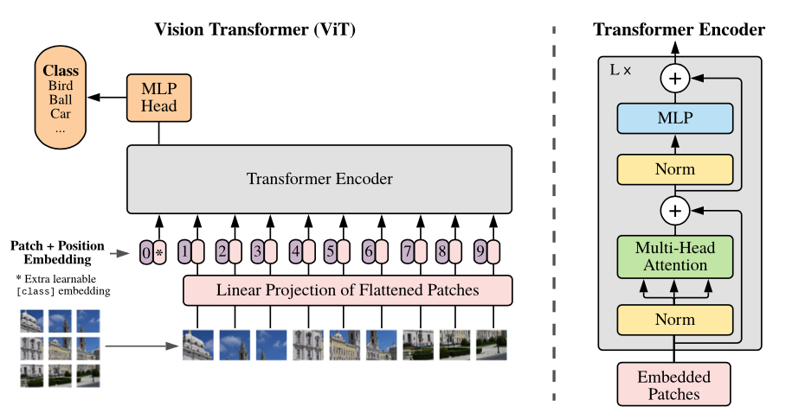
Vision Transformer (ViT) Model Architecture
Concept: apply pure transformer directly to a sequence of image patches.
Notes:
Split an image into fixed-size patches.
Flatten then linearly embed the patches.
Add 1D position embeddings.
Feed the sequence as input to a standard Transformer encoder.
Pretrain the model with image labels (fully supervised on a huge dataset)
Finetune on the downstream dataset for image classification

Slide 19

Vision Transformer (ViT) Operation

Slide 20
Vision Transformer (ViT) Author’s Observation
The lack of inductive biases (translation equivariance & locality) causes the models to not generalize well without sufficient data.
Large scale training on datasets with 14M-300M images trumps inductive bias.
When considering the computational cost of model pre-training, ViT performs very well.
Positional embeddings help improved performance, but more advanced embeddings bring no noticeable gain.

Slide 21
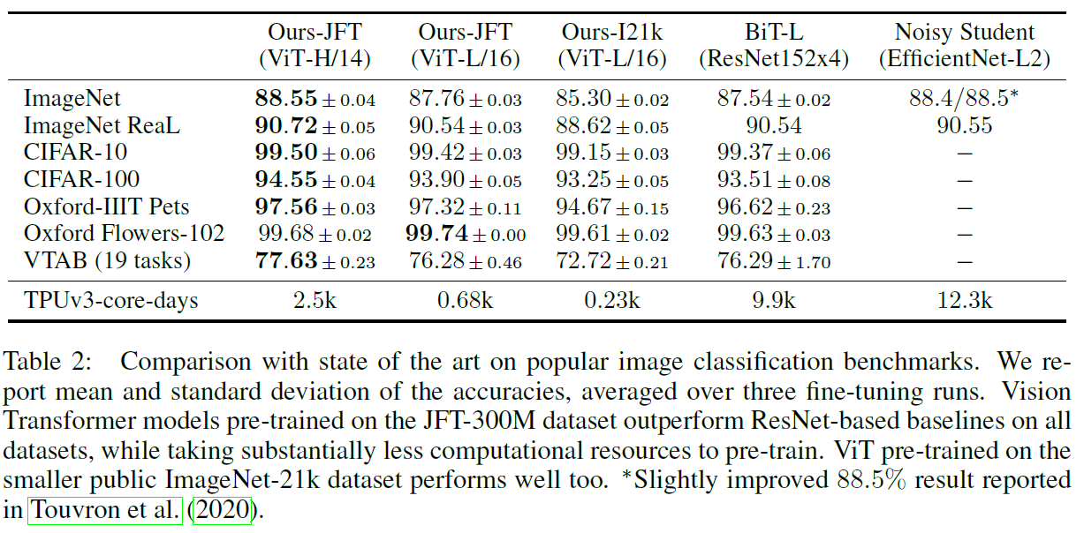
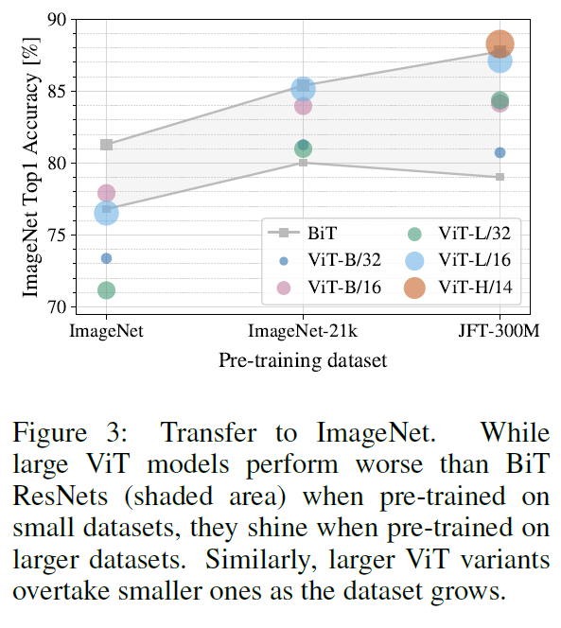
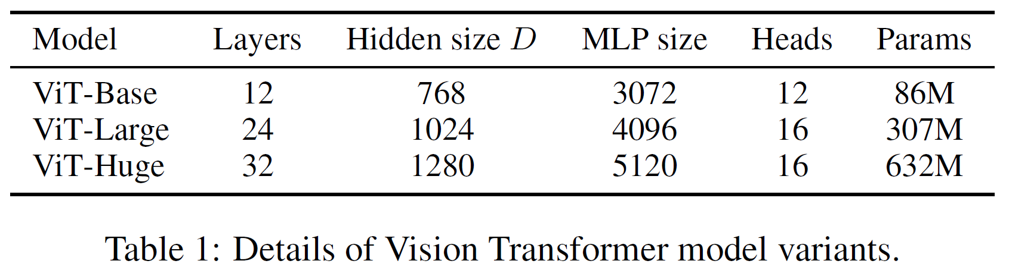
Vision Transformer (ViT) Experiment Results

Slide 22
Swin Transformers
Visual elements can vary substantially in scale unlike word tokens.
Much higher resolution of pixels in images compared to words in passages of text.
Many vision tasks require dense prediction at pixel level.
→ Swin Transformer as general-purpose backbone for various vision tasks.

Slide 23
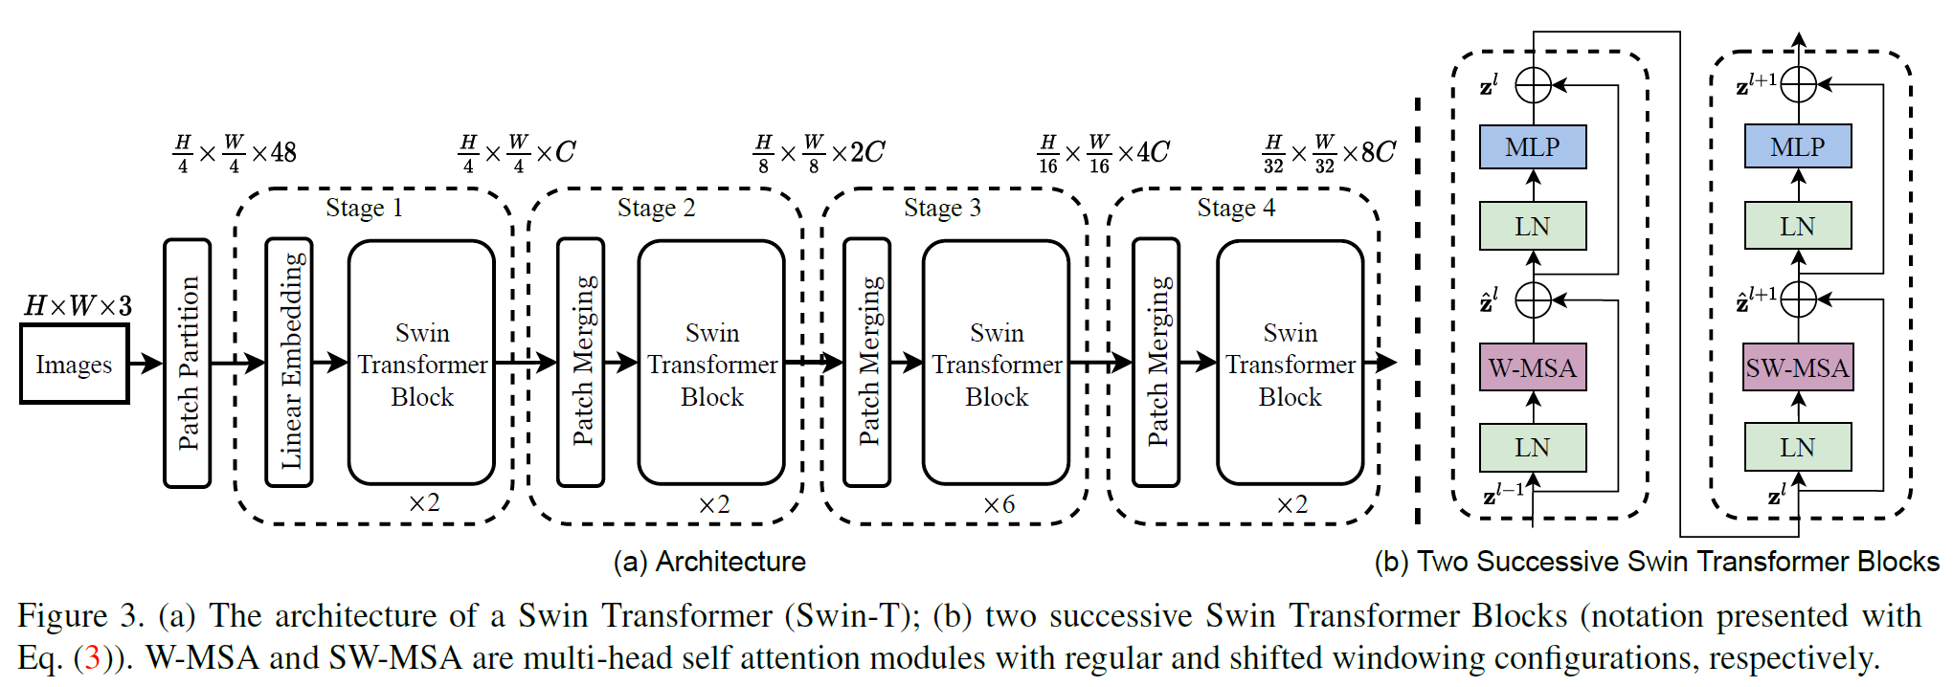
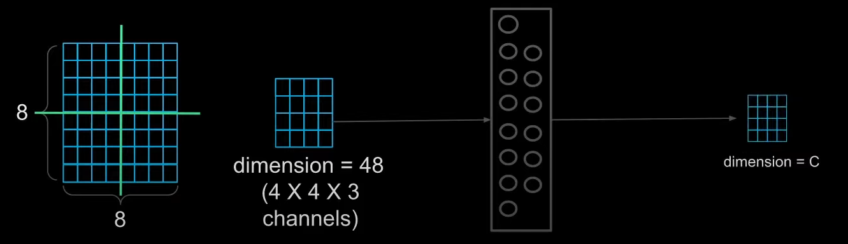
Swin Transformers Network Architecture
linear layer

Slide 24
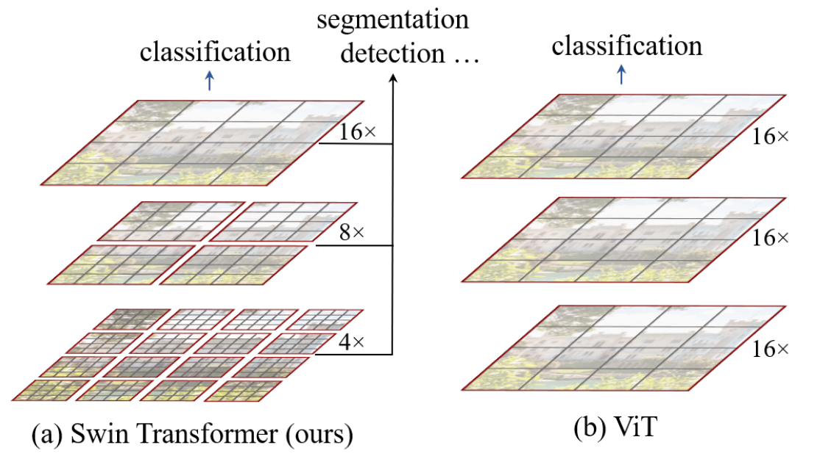
Swin Transformers Network Architecture
(a) The proposed Swin Transformer builds hierarchical feature maps by merging image patches (shown in gray) in deeper layers.
(b) In contrast, previous vision Transformers produce feature maps of a single low resolution.

Slide 25
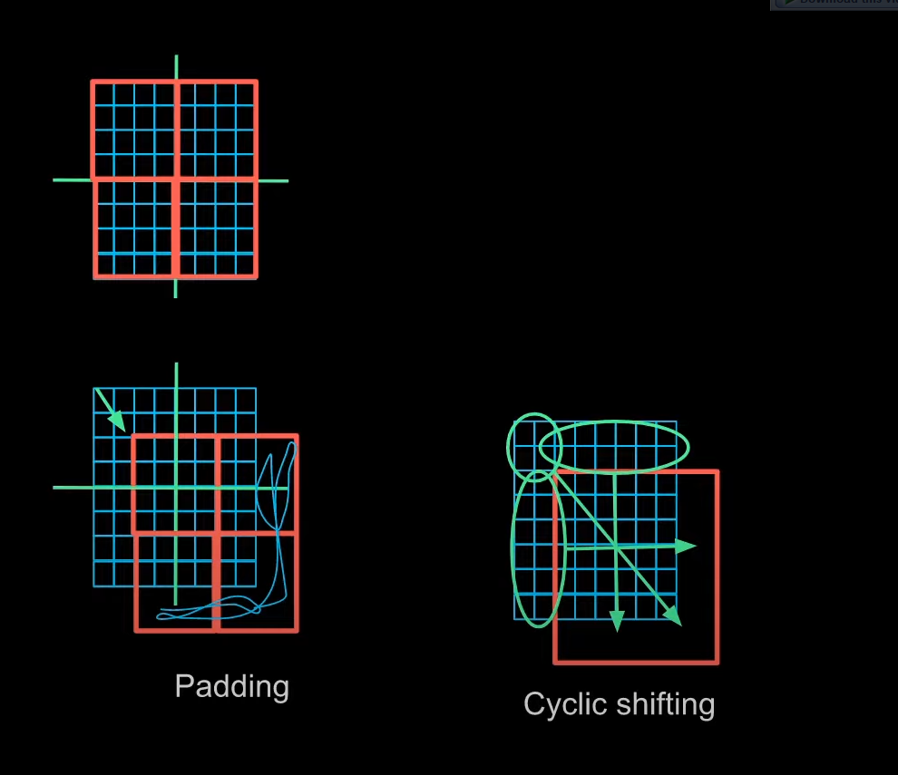
Swin Transformers Network Architecture
Swin Transformer block:
Resolves problem with global Multi-head Self-Attention (MSA) being too computational expensive.
Calculates self-attention within local windows (size = 7): Window based MSA and Shifted Window based MSA (alternatively).
W-MSA
SW-MSA
(Naive)

Slide 26
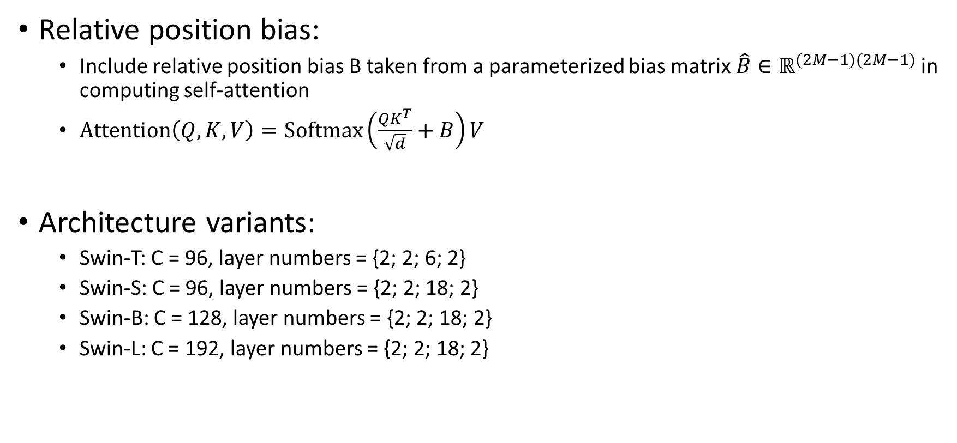
Swin Transformers Network Architecture
Relative position bias:
Include relative position bias B taken from a parameterized bias matrix$\hat{B}∈ℝ^{(2M−1)(2M−1)}$ in computing self-attention
$Attention\left(Q,K,V\right)=Softmax\left(\frac{QK^{T}}{\sqrt{d}}+B\right)V$
Architecture variants:
Swin-T: C = 96, layer numbers = {2; 2; 6; 2}
Swin-S: C = 96, layer numbers = {2; 2; 18; 2}
Swin-B: C = 128, layer numbers = {2; 2; 18; 2}
Swin-L: C = 192, layer numbers = {2; 2; 18; 2}

Slide 27
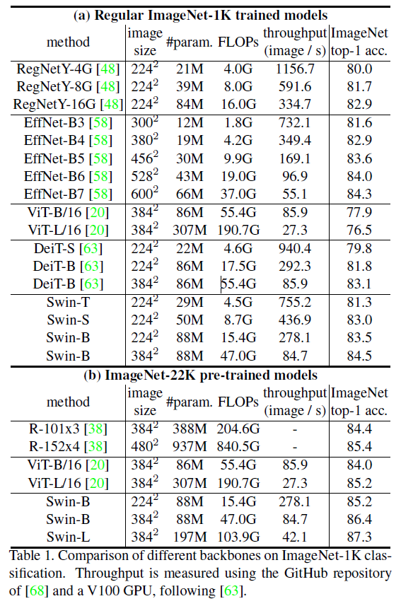
Swin Transformers Experiment results: Image Classification

Slide 28
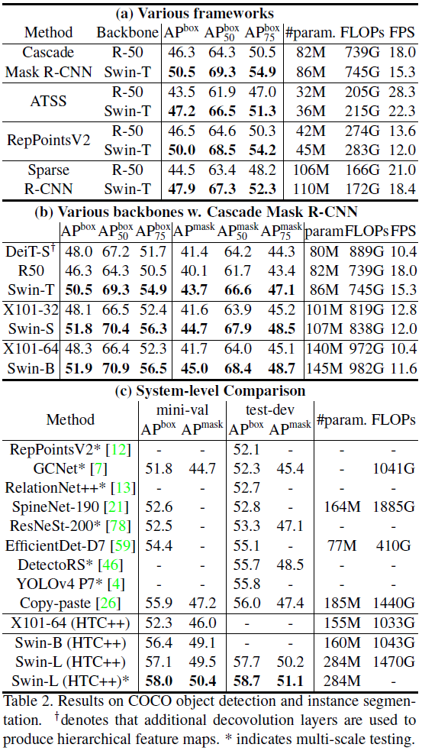
Swin Transformers Experiment results: Object Detection

Slide 29
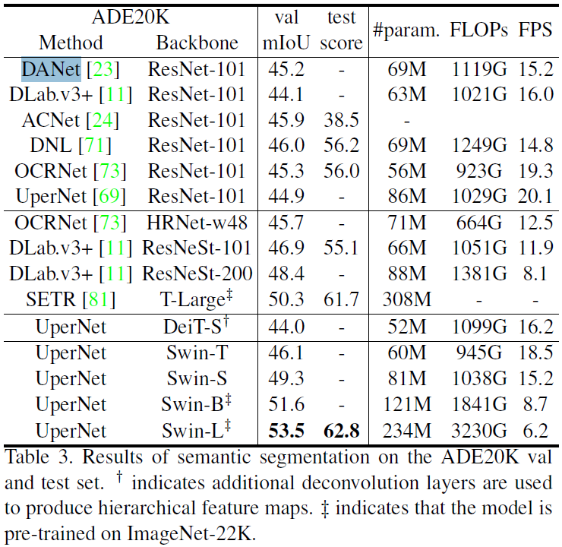
Swin Transformers Experiment results: Semantic Segmentation

Slide 30
Swin Transformers Significance
Hierarchical representation achieves scale-invariance and shifted windows approach efficiently conveys information within the local window.
General-purpose transformer backbone that can achieve SOTA performance.

Slide 31
Other references
Attention and its Different Form - https://towardsdatascience.com/attention-and-its-different-forms-7fc3674d14dc
Attention? Attention! - https://lilianweng.github.io/lil-log/2018/06/24/attention-attention.html
The Illustrated Transformer - https://jalammar.github.io/illustrated-transformer/
Attention and Transformer related articles - https://theaisummer.com/
Transformers for Image Recognition at Scale - https://ai.googleblog.com/2020/12/transformers-for-image-recognition-at.html
Vision Transformers (ViT) in Image Recognition – 2021 Guide - https://viso.ai/deep-learning/vision-transformer-vit/
A Comprehensive Guide to Attention Mechanism in Deep Learning for Everyone - https://www.analyticsvidhya.com/blog/2019/11/comprehensive-guide-attention-mechanism-deep-learning
How do Transformers Work in NLP? A Guide to the Latest State-of-the-Art Models - https://www.analyticsvidhya.com/blog/2019/06/understanding-transformers-nlp-state-of-the-art-models/
Swin Transformers: The most powerful tool in Computer Vision - https://sieunpark77.medium.com/swin-transformers-the-most-powerful-tool-in-computer-vision-659f78744871
Swin Transformer: Hierarchical Vision Transformer using Shifted Windows (paper illustrated) - https://www.youtube.com/watch?v=tFYxJZBAbE8

Slide 32
Thank you for listening

